Slide 1

HR Metrics and Analytics Presentation
By: Tahani Alotaibi

Slide 2
Introduction
In this presentation, we will explore the HR Metrics and Analytics aimed at answering the four key business questions related to human resources at MNC. The goal of this analysis is to provide actionable insights to improve HR operations and increase the overall efficiency of the company.
Data Source
A comprehensive dataset available on the Kaggle platform was used. This data includes detailed information about employees, including satisfaction level, job performance, the number of projects they are working on, monthly working hours, work accidents, promotions, and different work departments. This data allows us to analyze the factors affecting employee retention, satisfaction, recruitment efficiency, and performance in a detailed and comprehensive manner.

Slide 3
The presentation will be structured to answer the following questions:
Employee Performance Analysis: What are the key factors affecting employee performance, and how can we enhance these factors to improve productivity?
Recruitment Efficiency: How can we improve the efficiency of the recruitment process to reduce time and cost while increasing the quality of accepted candidates?
Employee Retention Rate: What are the main factors affecting the employee retention rate in the company, and how can we improve these rates?
Employee Satisfaction: What are the key factors influencing employee satisfaction, and how can we enhance these factors to improve the work environment?

Slide 4
Employee Performance Analysis: What are the key factors affecting employee performance, and how can we enhance these factors to improve productivity?

Slide 5
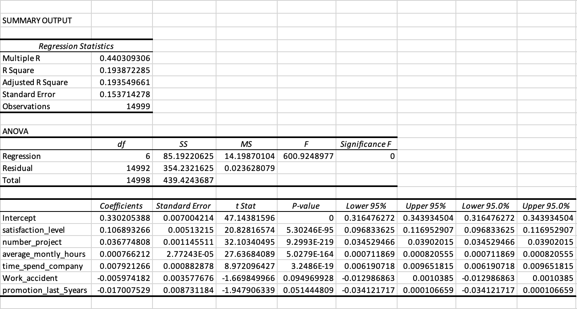
Satisfaction Level: It has a significant and statistically positive impact on job performance (P-value ≈ 0). Each unit increase in satisfaction level leads to an increase in job performance by 0.1068 units. Number of Projects: It has a significant and statistically positive impact on job performance (P-value ≈ 0). Each unit increase in the number of projects leads to an increase in job performance by 0.0367 units. Average Monthly Hours: It has a slight but statistically significant positive impact on job performance (P-value ≈ 0). The effect is very small (0.0007 per unit). Time Spent at Company: It has a significant and statistically positive impact on job performance (P-value ≈ 0). Each unit increase in the time spent at the company leads to an increase in job performance by 0.0079 units. Work Accidents: It has a negative but not statistically significant impact on job performance (P-value ≈ 0.1). The effect is negative by -0.0059 per unit. Promotion in Last 5 Years: It has a slight but not statistically significant negative impact on job performance (P-value ≈ 0.05). The effect is negative by -0.0170 per unit.
Through the multiple regression analysis conducted on the available data, we were able to identify the key factors affecting employee performance. The results are as follows:
We can see that the most influential factors on job performance are satisfaction level, number of projects, and time spent at the company. Therefore, the company can focus on improving these factors to enhance job performance. Regarding work accidents and promotions, although there are slight effects, they are not significant enough to cause immediate concern but can be monitored to improve overall performance.

Slide 6
Analysis of Key Factors Influencing Job Performance
1- Satisfaction Level
This scatter plot illustrates the relationship between the average satisfaction level and the average last evaluation score of employees. We can observe a general trend where higher satisfaction levels are associated with higher last evaluation scores. There are fluctuations indicating that while satisfaction is a strong predictor of performance, other factors might also influence the evaluation scores.
The scatter plot demonstrates a positive relationship between employee satisfaction and performance evaluation. Employees with higher satisfaction levels tend to receive higher performance evaluations, underscoring the importance of maintaining a satisfied workforce.
Based on the analysis, we conclude that satisfaction levels significantly impact employee performance.

Slide 7
Analysis of Key Factors Influencing Job Performance
2- Number of Projects:
This chart shows the relationship between the average last evaluation score and the number of projects employees are working on. It can be observed that employee performance tends to improve with an increasing number of projects, as the average last evaluation score rises with the number of projects.
The chart illustrates a positive correlation between the number of projects employees are involved in and their performance levels. Employees who participate in more projects tend to achieve better performance, suggesting that multiple challenges can serve as a motivator for enhanced performance.
Based on the analysis, we conclude that increasing the number of projects employees work on can lead to improved job performance. Therefore, the company should encourage employees to take on more projects and provide the necessary support to manage them effectively.

Slide 8
Analysis of Key Factors Influencing Job Performance
3- Average Monthly Hours:
This scatter plot illustrates the relationship between the average performance (last evaluation score) and the average monthly hours worked by employees. The plot shows that higher performance scores are generally associated with higher average monthly hours.
The scatter plot indicates a positive correlation between average monthly hours and employee performance. Employees who work more hours per month tend to receive higher evaluation scores, suggesting that increased working hours contribute to better performance.
Based on the analysis, it can be concluded that increasing average monthly working hours may lead to improved job performance. The company should consider monitoring and optimizing working hours to ensure employees are productive without experiencing burnout.

Slide 9
Analysis of Key Factors Influencing Job Performance
4- Time Spent at Company:
This line chart shows the relationship between average performance (last evaluation score) and tenure duration (number of years). It demonstrates how performance changes with increasing tenure duration.
The chart indicates that there is a fluctuation in performance based on tenure duration. Generally, it is observed that performance peaks when the tenure is between 4 and 6 years and then starts to decline slightly.
Based on this analysis, the company can focus on retaining employees for a tenure of 4 to 6 years, where performance reaches its highest point. To achieve this, the company can implement strategies to encourage employees to stay longer, such as providing training and development opportunities and promotions.

Slide 10
Analysis of Key Factors Influencing Job Performance
Non-Numeric Factors
In the multiple regression analysis, we analyzed only the numeric factors. However, there are important non-numeric factors that may impact job performance, such as salary level and the department in which the employee works. We represented these factors using charts to understand their influence on job performance.
5- Salary:
This pie chart illustrates the distribution of average job performance evaluations across three salary levels: high, medium, and low. Each segment of the pie chart represents a different salary level and its corresponding average performance evaluation score.
High Salary Level: Employees with a high salary level have an average performance evaluation score of 0.72, which constitutes 34% of the total evaluations.
Medium Salary Level: Employees with a medium salary level also have an average performance evaluation score of 0.72, making up 33% of the total evaluations.
Low Salary Level: Employees with a low salary level have a slightly lower average performance evaluation score of 0.70, which represents 33% of the total evaluations.
The analysis shows that there is a slight variation in job performance evaluations based on salary levels. Employees with high and medium salary levels tend to have similar performance evaluation scores, which are marginally higher than those with low salary levels. This suggests that higher salary levels may be associated with slightly better job performance. However, the difference is not substantial enough to indicate a strong correlation. Therefore, while salary level might have a minor influence on job performance, other factors likely play a more significant role in determining overall job performance.

Slide 11
Analysis of Key Factors Influencing Job Performance
6- Department
This bar chart shows the average performance evaluation scores for employees across various departments. Each bar represents a different department and its corresponding average performance evaluation score.
Highest Scores: Management and support departments (~0.73).
Moderate Scores: Technical, accounting, IT, marketing, product management, and RandD departments (0.70 - 0.72).
Lowest Scores: Sales and HR departments (~0.70).
The analysis reveals that there are variations in job performance evaluations across different departments. Management and support departments have the highest average performance evaluations, indicating potentially better performance in these areas. On the other hand, HR and sales departments have the lowest average performance evaluations, suggesting areas that might require further attention to improve performance.

Slide 12
Conclusions and Recommendations
Conclusions
We observe that there are five factors affecting employee performance:
Satisfaction Level: Found to have a statistically significant positive impact on job performance.
Number of Projects: Found to have a statistically significant positive impact on job performance.
Average Monthly Hours: Has a slight but statistically significant positive impact on job performance.
Time Spent at Company: Has a statistically significant positive impact on job performance.
Department: Variations in job performance were observed between different departments.
Recommendations
1-To improve satisfaction levels: I suggest providing a supportive and motivating work environment, enhancing communication between employees and management, offering performance-based incentives and rewards, organizing social events and recreational activities to foster team spirit, and developing flexible work policies that allow for remote work when needed.
2- Encourage employees to participate in multiple projects and present them with new and diverse challenges to develop their skills and motivate them. Provide the necessary training and support to manage projects effectively and ensure the workload is distributed fairly among employees to prevent burnout.
3- Monitor and optimize working hours to prevent burnout and provide flexibility in work schedules to ensure a balance between professional and personal life. Additionally, offer programs to train employees on effective time management.
4- Provide clear promotion pathways and encourage retention by offering long-term incentives, professional development programs, and clear growth opportunities.
5- Identify low-performing departments and provide necessary support to improve them (such as HR and Sales in this case). Organize training sessions and workshops to enhance the required skills in these departments and promote collaboration between different departments to share experiences and best practices.

